Slide 1
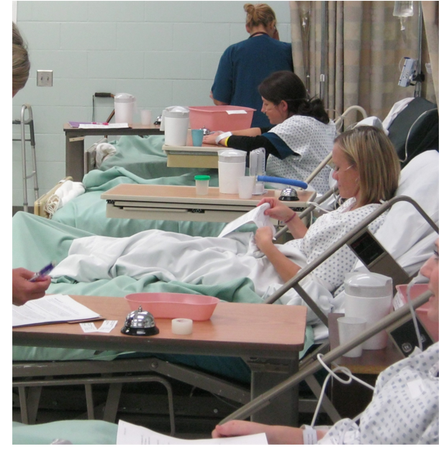
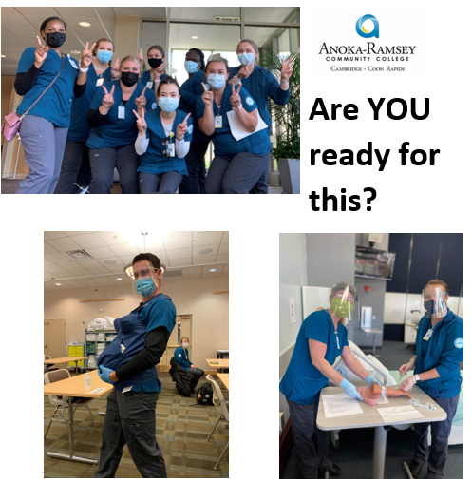
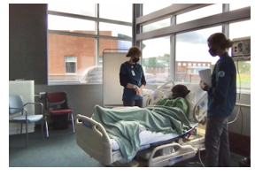

Slide 2
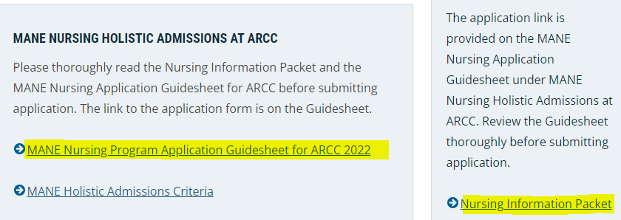
Knowing expectations and following directions are key indicators of success in the MANE nursing program and the nursing profession
Everything you need to know about applying to the MANE Nursing Program at ARCC is available on the ARCC website.
Wise applicants will read everything about the program, especially the Nursing Information Packet and the MANE Nursing Program Application Guidesheet documents posted on the ARCC website before opening the application form: http://www.anokaramsey.edu/academics/degrees-diplomas-certificates/associate-degrees/associate-of-science-degrees/nursing/

Slide 3
Nursing Application INFORMATION Anoka-Ramsey Community College (ARCC) Spring 2023
The primary purpose of this session is to offer insight on what the Admissions Review Team is looking for in the Experience and Attributes sections of the MANE nursing application.
How does Holistic review of MANE nursing applications at ARCC work?
The Admissions Review Team first confirms you have completed the required prerequisite courses with a minimum 2.75 GPA and provided an ATI TEAS score. The GPA and TEAS are the “Metrics” portion of the application.
When the Metrics portion of the nursing application is verified, the remainder of the application, the “Experience” and “Attributes” sections, is evaluated.
Notes:
March 19-May 24, 2022

Slide 4
Notes:
Any TEAS score is accepted; no credit awarded for TEAS below proficient >58.7%

Slide 5
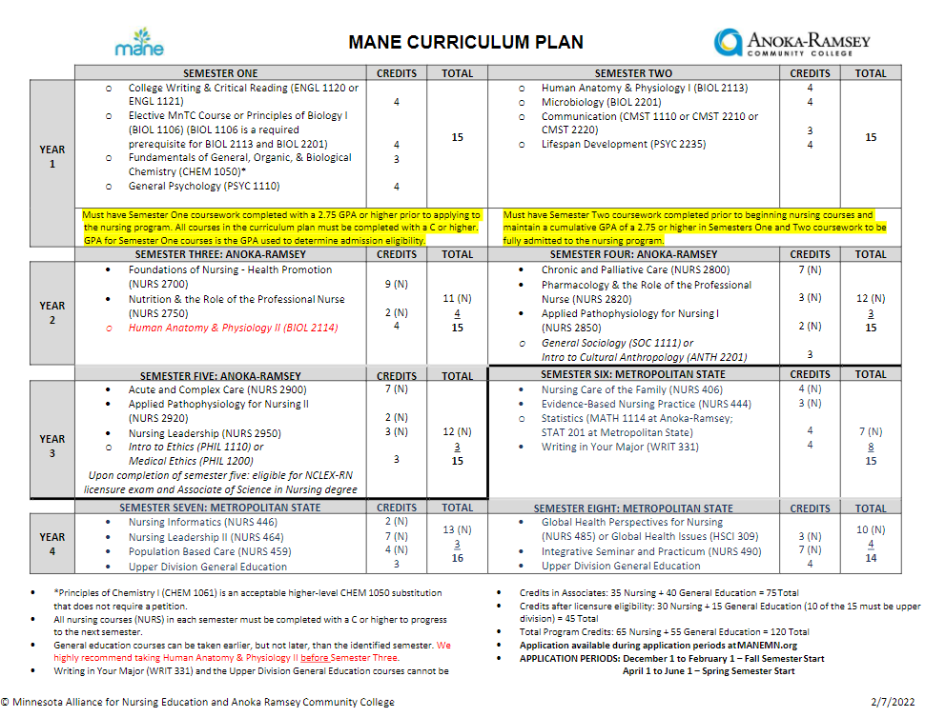

Slide 6
Experiences – weighted at 40% in admission Review 2 Related Questions on Nursing Application:
[Service]Work/Volunteer Experiences: List up to five work or volunteer experiences that were or are most impactful for you. Provide name of organization, position/role, and timeframe of involvement.
Lived Experience: 250 words or less and may be typed or cut and paste. Do not include your name in essay. “Describe your personal lived experiences outside of work and educational experiences. Include how this inspires you to become a nurse and what this teaches you about the commitment and drive it takes to be a successful and committed nurse.”

Slide 7
[Service]Work/Volunteer Experiences: List up to five work or volunteer experiences that were or are most impactful for you. Provide name of organization, position/role, and timeframe of involvement.
What comes to mind when someone asks how you’ve spent your time? Work? Volunteer? Caregiver? Try to list 5. If you were at the same facility for several years, list separate roles served. Example:
Organization Title of Position/Primary Role Timeframe of Involvement
Sally Group Home Volunteer (card games with residents) December 2013 - 2014 weekly
Sally Group Home CNA December 2015 - present
LPN, CNA, EMT, MA, phlebotomist, home care aid; any healthcare experiences
health care experience is not required, but many students that have no exposure to the health field pursue CNA certification or other health care initiatives
include service experiences: wait staff, hair stylist, barista, taxi, retail or customer service of any kind
are you or have you been a primary caregiver, do you have children or provide foster care?
indicate if you are a full-time or PSEO student, or part of TRIO or the SUCCESS program on campus
engagements at church or in community as a mentor, tutor, peer counselor, Girl/Boy Scouts volunteer, or other volunteer efforts at your or your kids' schools
if you feel you have nothing to list, consider engaging in new volunteer opportunities (nursing homes, church daycare, food shelf, hospital, Feed My Starving Children, or any non-profit volunteering)

Slide 8
Lived Experience: 250 words or less and may be typed or cut and paste. Do not include your name in the essay. “Describe your personal lived experiences outside of work and educational experiences. Include how this inspires you to become a nurse and what this teaches you about the commitment and drive it takes to be a successful and committed nurse.”
Tell your personal story, outside of your work or school experiences. Write about an event, accumulation of events, or your path to nursing that portrays your life journey, passion, resilience.
What made you want to be a nurse? If it is a personal/family health experience, describe this and how it impacted you. What obstacles did you overcome? It is great if you come from a family of nurses, but describe HOW that inspires you, teaches and drives you. Be personal. Start your story with something precise. Examples:
•As a volunteer at Jack’s Rehab, I watched a car crash victim go from invalid to runner
•I was a realtor for 10 years and never felt fulfilled until I met my RN neighbor
•My (or my child’s) dyslexia was diagnosed in 10th grade
•I am a cancer survivor
•My family moved 17 times in 6 years when dad was in the military
If no obstacles or challenges come to mind, write about what inspires and teaches you in relation to your nursing journey. If you have overcome a significant challenge, create balance between that trauma and healing to show not only who you were/are in the event, but who you have become in the process. Describe how you have developed support or self-care.
Consider how your values align with nursing: innovation, collaboration, integrity, respect, accountability, diversity and inclusiveness, or responsiveness to others.

Slide 9
ATTRIBUTES - weighted at 40% in admission review 3 Related questions on Application:
Other Educational & Training Experiences: List up to five other educational or training experiences that were or are most impactful for you. Provide name of organization, title of experience, and timeframe of involvement .
Teamwork/Collaboration & Accountability: 250 words or less and may be typed or cut and paste. Do not include your name in essay. “Describe a situation in your life that demonstrates your experience with Teamwork/Collaboration & Accountability. What was your role and what was the outcome of this experience?”
Beliefs and Values: 50 words or less and may be typed or cut and paste. Do not include your name in essay. “Briefly describe a person or one experience that has prepared you to care for diverse populations. Specifically, with respect for the dignity, worth and human rights of all individuals.”

Slide 10
Other Educational & Training Experiences: List up to five other educational or training experiences that were or are most impactful for you. Provide name of organization, title of experience, and timeframe of involvement.
Do NOT repeat what you provided in the previous Experiences question.
Do your best to list 5 experiences that show you pursue growth. How did you or do you spend your time outside of work, school or volunteering?
specific trainings or workshops related to previous or current job or volunteer experience; what did you have to learn to prepare for your Work/Volunteer experiences?
diversity awareness/equity and inclusion, first aid/CPR/AED, crisis management, conflict resolution, self-care, infection control, safety and emergency, etc.
military service/ROTC trainings
self-development opportunities such as home community education workshops/courses, technology training (online modules, software used for school, etc.)
second language/ASL interpreter training
did you lead or participate in any clubs or events while taking classes?
do you have specific training on home care/interventions as care giver (nebulizer, spirometer)

Slide 11
Teamwork/Collaboration & Accountability: 250 words or less and may be typed or cut and paste. Do not include your name in the essay. “Describe a situation in your life that demonstrates your experience with Teamwork/Collaboration & Accountability. What was your role and what was the outcome of this experience?”
Do not provide a description of teamwork.
Do not describe your leadership skills or give example of your leadership skills.
Describe a specific situation you have encountered in a team situation; include your role or task (how you contributed) and the outcome or result. Consider using the S.T.A.R. format. Example:
Situation – electricity went out in the nursing home during a bingo game with 12 clients; 8 were in wheelchairs
Task – we needed clients to remain calm and stay in the room for their safety as hallways were too dark
Action – one staff called Excel Energy to report the outage; my role was to distribute a flashlight to each table, answer questions and address any personal needs; another staff monitored the exit (some agitated clients wanted to leave) and we took turns announcing updates periodically
Result – power was back on in 20-minutes and everyone stayed safe and even entertained when one client played the piano for a bit!

Slide 12
Beliefs and Values: 50 words or less and may be typed or cut and paste. Do not include your name in the essay. “Briefly describe a person or one experience that has prepared you to care for diverse populations. Specifically, with respect for the dignity, worth and human rights of all individuals
Do not simply state “I work with a diverse group.”
If a person, a job task, or a volunteer experience prepared you to care for diverse populations, describe what it was in that person or experience that prepared you. It might relate to a language barrier, disability, socioeconomics, patient with no family or support, different religious beliefs, etc.

Slide 13
How should I respond to the questions on the nursing application?
Truthfully
Thoroughly
Thoughtfully
Expert writing skills are not expected; informative content is expected.

Slide 14
Can I get help with the essay questions on the application?
The ARCC Writing Center/Academic Support Center offers limited writing tutoring services for current ARCC students.
http://www.anokaramsey.edu/resources/tutoring-services
ARCC Advisors cannot review or proofread nursing applications.

Slide 15
Job readiness services and resources for ARCC Students
A solid resume is another great way to gather information for your nursing application! Meet with Ryan for assistance with:
Searching for Job Opportunities
Resume and Cover Letter Writing
Networking (LinkedIn)
Interviewing
Ryan Hanson, Coordinator of Job Readiness Services and Resources
Anoka-Ramsey Community College
Coon Rapids and Cambridge Campuses
Email: ryan.hanson@anokaramsey.edu
Schedule an appointment with me

Slide 16
Important REMINDERS when completing your NURSING application to ARCC
Prerequisite courses differ between MANE campuses. Research requirements before applying. Example: applicants that have never taken a Chemistry course should not apply to the nursing program at ARCC.
If you submit more than one application during this application cycle, MANE will only use your first submission.
You have 30 minutes to complete the application so you may want to prepare your answers to cut and paste when ready to complete.
Submit your application by the stated deadline: 11:59p.m. on June 1, 2022.
A decision notification will be emailed to you by noon on August 1, 2022.

Slide 17
Questions?
Continue to work the ARCC Academic Advisor you are assigned to or contact
Mary Pietruszewski
Nursing Admissions Advisor
nursingadmissions@anokaramsey.edu
Please provide your name and ARCC Tech ID in all inquiries.

Slide 18
